Slide 1

The Big 5.
Game Project presentation

Slide 2

Game Ideas
Tic Tac Toe
01
Soduku
02
Draft / Checkers
03
Guess A number game
04
Mathematics games
05
Guessing the names of people who came up with famous Quotes
06
These are all the gaming ideas that I currently have , but if anyone wants to add we can add his/her idea, and the we will choose which games we will include in our app
We are going to use android v.8 or v7.

Slide 3
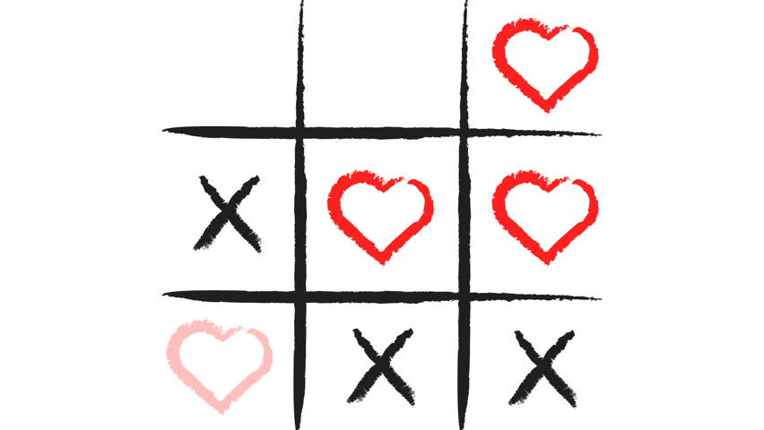
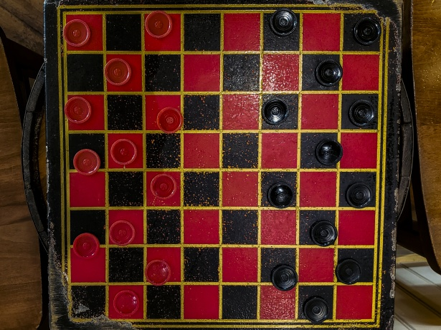
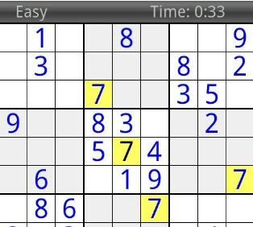
This Photo by Unknown Author is licensed under CC BY-NC-ND

Slide 4
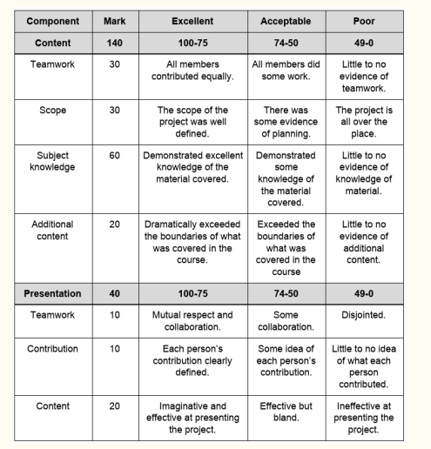
Important Rules
Any plagiarised code – mark times zero .
Reference the author when you use code (this code will not be awarded marks but you will not be penalized).
Also note that some of us are good at programming but we are not good artist.
Your ideas on how the game should look like are important to us all (meaning if your have an idea share it with us, we will all discuss it and come with a conclusion as a team ,if we are using your idea or not

Slide 5
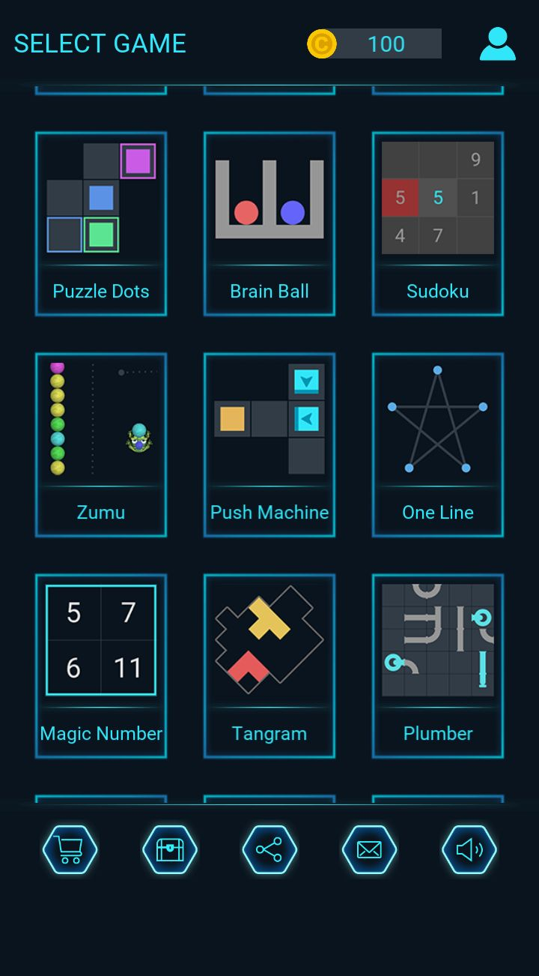
Game Layout.
We need a name for our app.
We need to choose the Icon(logo) for our app.
Inside the app we have to choose logo for each game.
We have to choose colour for the background of the app/ we could use a beautiful picture as our background.
Also we must choose the home page of the App.

Slide 6

How to keep players engaged in our App
Some us this is our first App/game to make, we gonna exclude many things that we usually see in some games; like missions and rewards (if possible)
This app/game must have some levels (like from level one to 10 and it must start from easy levels to hard levels.
If possible we can add some nice background sound that the player will hear when gaming.
We must also note the colour that we are going to use in our game(Studies found that people are attracted to colours such as Red , Blue, Green and Pink, so I think these colors will be perfect for our game as they attract many users

Slide 7

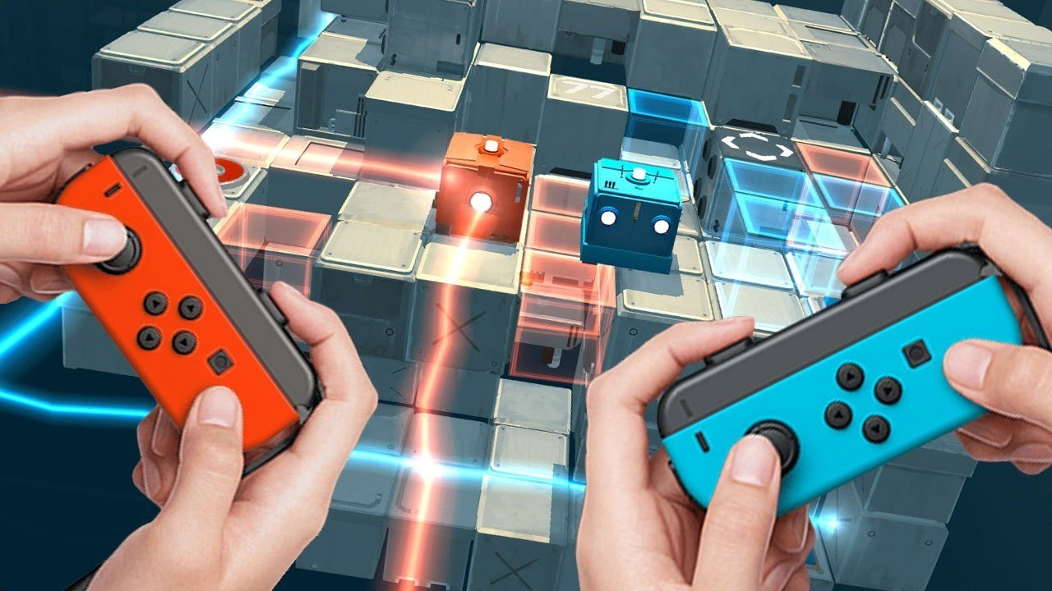

Some Thing to not Forget
Each and every game will have its rules and Hits.
We all know how rules and hints in games work
If possible we can make our game to have rewards as the player level up.
If possible we can make it to have multiplayer.
it must take user name and count the score of that certain user.

Slide 8
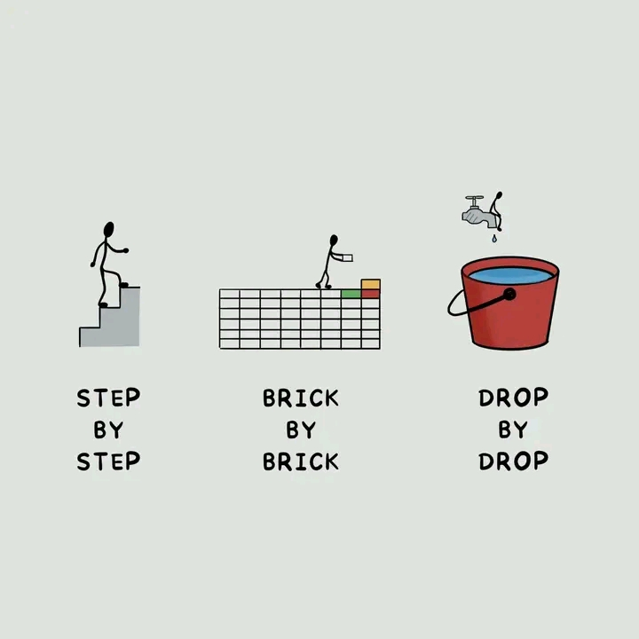
This is not going to be an easy road people so we must try by all means to finish this game even if its not perfct, but we must try.
Also try to make all your courses balance .
This should be on your top five important things
Try to learn how to use android studio.
Try to write maybe approximately 5 lines of code each day, but don’t submit it in the GitHub resporatoy , submit it when you have approximately 50 lines of code .
Always check the respiratory so that you don’t repeat writing lines that have been already written by someone else.
Feel free to also ask for anything in the group , REMEMBER WE ARE ALL HERE TO LEARN, SO WE DON’T EXPECT YOU TO WRITE PERFECT CODES BUT PLEAS E TRY TO MINIMIZE YOUR ERRORS .
ALSO DON’T FORGET TO PUT COMMENTS ON YOUR CODES .
We will have weekly meetings maybe 0nce or three times a week

Slide 9
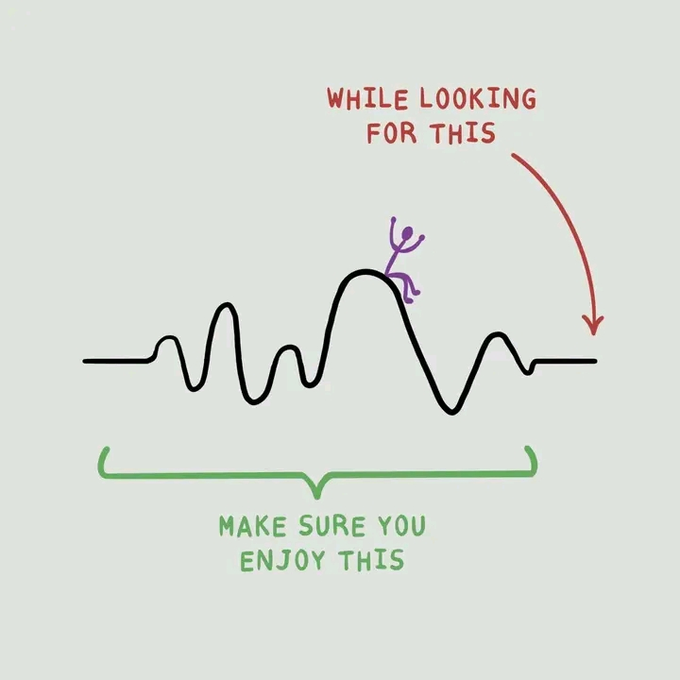

Slide 10
